Slide 1

#1
Do you prefer
Online Shopping ?
1. Yes 2. No

Slide 2

Q-Trace
#4
Smart Parcel Tracking Service

Slide 3

What are the issues ?
#2

Slide 5
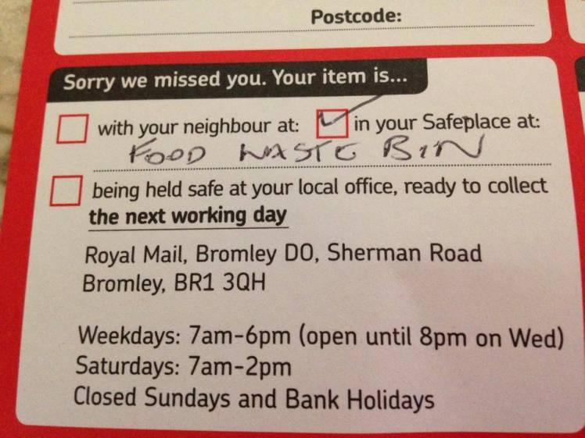

#3

Slide 6

#5
What do we provide?
Reliable Tracking Service
Dynamic Destination Address Service
Better user experience
Seller ←→ Delivery Service
Delivery Service ←→ Buyer
Seller ←→ Buyer

Slide 7

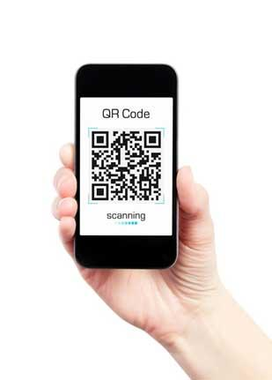

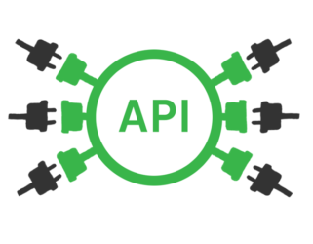
#6
APIs for seller
Mobile App for
Delivery Service
Web App for Buyers

Slide 8

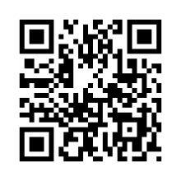
#7
How Reliable Tracking happens ?
The seller can create QR code stamp using “our APIs” and stick it on the package.
Receiver’s Name
House Number,
Street,
Town
ABC-12345678-D

Slide 9
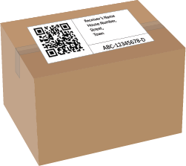
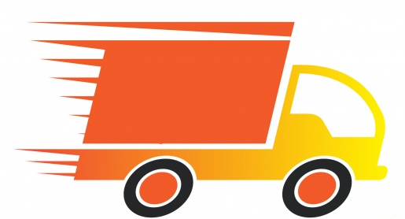
#8
How Reliable Tracking happens ?
The seller can create QR code stamp using “our APIs”.
Delivery service can scan the QR code using “our App” at each parcel exchange.

Slide 10

#9
How Reliable Tracking happens ?
The seller can create QR code stamp using “our APIs”.
Delivery service can scan the QR code using “our App” at each parcel exchange.
Delivery agents can be tracked using GPS.

Slide 11
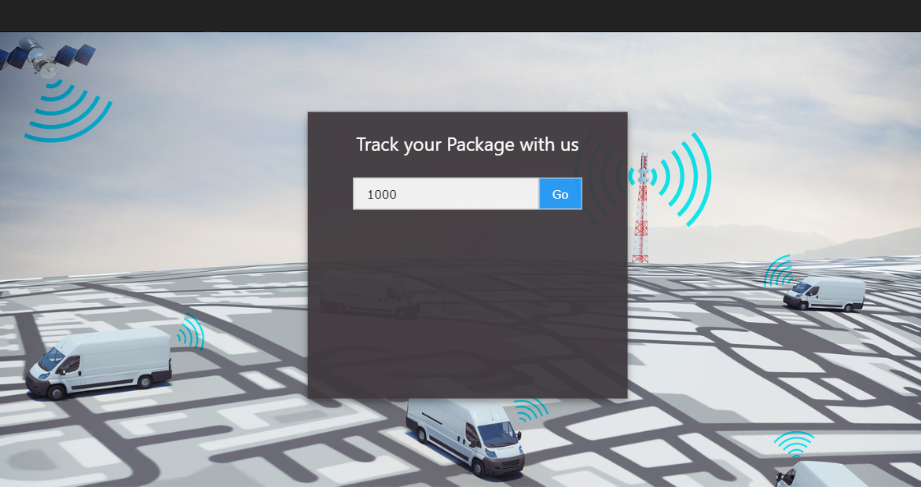
#10
How Reliable Tracking happens ?
The seller can create QR code stamp using “our APIs”.
Delivery service can scan the QR code using “our App” at each parcel exchange.
Delivery agents can be tracked using GPS.
Buyers can track their parcels using our “Web App”
ABC-12345678-D

Slide 12
#11
Dynamic Destination Address Service
“You can change your receiving address, even after dispatch from the seller”
Example
You gave your home address as “Destination Address”.
You know you will receive the parcel today, but today you’re not at home.
You can update your pickup place* as your workplace
or
ask to hold the parcel for today.
* Will add extra some charge for the delivery

Slide 13

How revenue generates ?
#12
“Our production is based on a problem currently exist,
so we can introduce this solution to the sellers and delivery services”
API Market
We will release our platform as Web APIs. (Application Programming Interface)
Any selling, delivery company can register with these APIs and take the advantages of our platform.
Charging per number of API requests.
Technical support
We can provide technical support to these companies.
Integrate our platform with mobile apps, websites etc…

Slide 14


Slide 15


Slide 18

Feature Improvements
Dynamic Destination Addresses
Rules based destination address
Provide Cash on Delivery Service
The client can pay using his/her bank account through the app.
The mobile app can analyze its previous data and correctly estimate a high precision delivery time from one location to other.
GPS enabled tracking device for delivery vehicles.

Slide 19





Technologies will be used
HTML, JavaScript (jQuery) & CSS for frontend development
PHP, MySQL for backend development
HTTP Restful APIs (JSON)
Apache Cordova for Mobile App Development
(Supports hybrid mobile app development; Android, Windows & iOS )

Slide 20

What will be done in the Hackathon?
Develop the essential platform futures
qTrace Deliver App
qTrace Parcel Tracking Site
IoT based tracking device

Slide 21

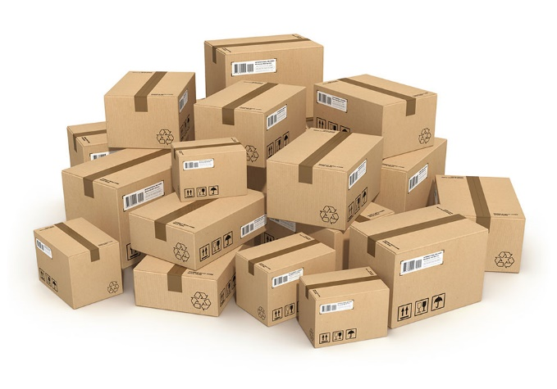
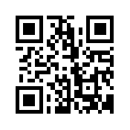
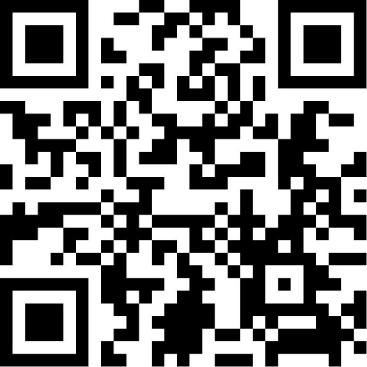

Slide 22



Index
#17
#18
#19
#20

Slide 23
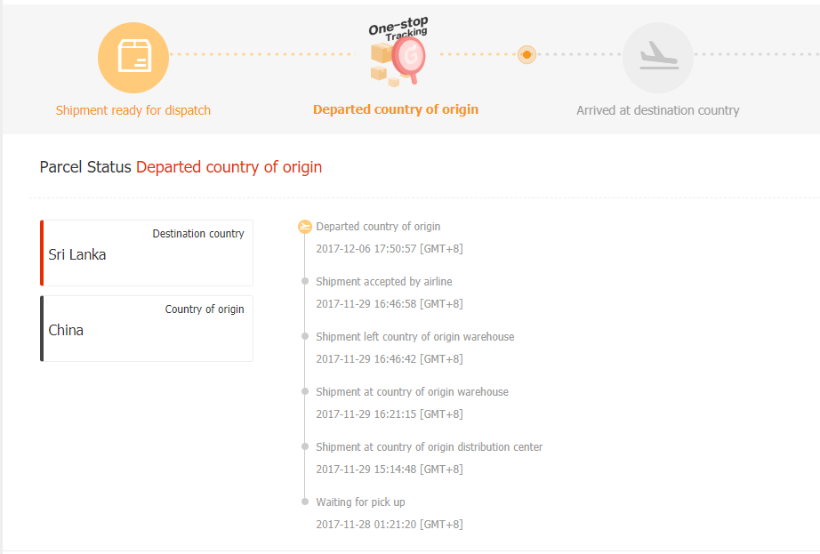
#21

